Slide 1
Default transport model for products produced and consumed in Switzerland
Valsasina, L., Lévová, T.
SETAC Case Studies, Montpellier, France
September 2016
Tereza Lévová
Senior Data Analyst
ecoinvent

Slide 2
Table of content
Introduction
Transport data availability
Global transport model in ecoinvent v3
Improvements of the global model
Swiss transport model
Quality assessment of the new data
Conclusion

Slide 3
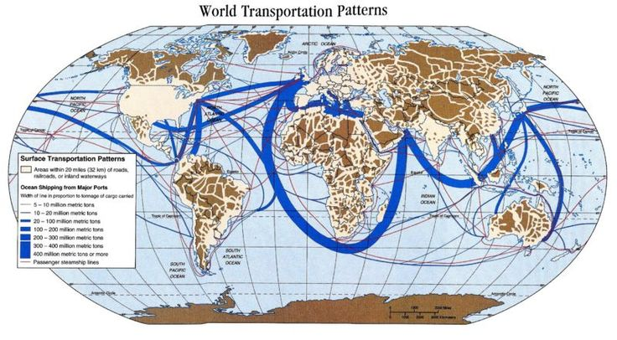
Introduction Transport of goods in the world
The transport of goods around the globe is ever increasing. More and more products are being traded all over the world.
How can the global amounts of transport be included in the LCI activities?
Source: Allen, John, Student Atlas of Anthropology, First Edition

Slide 4
Transport data availability Sources of data on transport – amounts and distances
European statistics
Eurostat database, statistics on transport in the EU countries
USA statistics
United States Department of Transportation, Bureau of Transportation Statistics
ton*km (mile*km)
-> one tone of goods being transported over the distance of one kilometer
ton-kilometer (ton*km) =
weight of goods
(including packaging)
*
distance transport (by mode)
Notes:
Eurostat -> http://ec.europa.eu/eurostat/web/transport/data/database
USA -> http://www.rita.dot.gov/bts/sites/rita.dot.gov.bts/files/publications/commodity_flow_survey/index.html

Slide 5
Transport data availability Classification
Economic activities
Products
Transport
Global
ISIC
CPC
Continent level
NACE
CPA
SCGT (US)& NST (EU)
National level
NOGA
National version
National statistics
Notes:
Inspired by: http://ec.europa.eu/eurostat/statistics-explained/index.php/File:International_system_of_classifications.PNG
NASE - Nomenclature statistique des activités économiques dans laCommunauté européenne (http://ec.europa.eu/eurostat/statistics-explained/index.php/Glossary:Statistical_classification_of_economic_activities_in_the_European_Community_(NACE))
CPA – is the classification of products (goods as well as services) at the level of the European Union (EU). (http://ec.europa.eu/eurostat/statistics-explained/index.php/Glossary:Statistical_classification_of_products_by_activity_(CPA))
ISIC – International Standard Industrial Classification of All Economic Activities (published by the UN)
CPC – Central Product Classification (published by the UN)
NOGA - Nomenklaturen – Allgemeine Systematik der Wirtschaftszweige (http://www.bfs.admin.ch/bfs/portal/de/index/infothek/nomenklaturen/blank/blank/noga0/vue_d_ensemble.html)

Slide 6
Global transport model ecoinvent v3 Construction of the global transport model
total transport in the world
USA
transport data
EU transport data
ISIC
CPC
ecoinvent v3
GLOBAL MODEL
ecoinvent v3
1
175
20
>460
>4590
>2800
01 Products of agriculture, hunting, and forestry; fish and other fishing products
0122 Growing of tropical and subtropical fruits
market for banana /GLO
03 Other agricultural products
01312 Bananas
Notes:
ISIC – International Standard Industrial Classification of All Economic Activities (published by the UN)
CPC – Central Product Classification (published by the UN)

Slide 7
Global transport model ecoinvent v3 More detailed information - market regionalisation
In ecoinvent v3 every single product has to have at least one global market this market will have a transport distances calculated based on global model on transport distances
Is that enough detail?
While many products are traded globally some are traded regionally
Construction materials (gravel, concrete, stone)
Products with low price and high volumes (tap water)
Products which technically cannot be transported (electricity, steam)
Waste products
Infrastructure (buildings, landfills)
Need for regional markets and transport distances!

Slide 8
Improvements of the global model Steps towards more regionalised transport model
What is the amount of t*km of transport of an average 1kg of gravel?
total amount of transport of goods in the world
TOP
DOWN
global transport distances for several product groups and transport modes
Global transport model present in ecoinvent v3
continent - specific transport distances for several product groups and transport mode
country - specific transport distances for several product groups and transport modes
Swiss Transport model
UP
BOTTOM
country - specific transport distances for all the specific products
data NOT available
Notes:
Very specific data for a specific product traded on specific market can be used and incorporated on top of the global model.

Slide 9
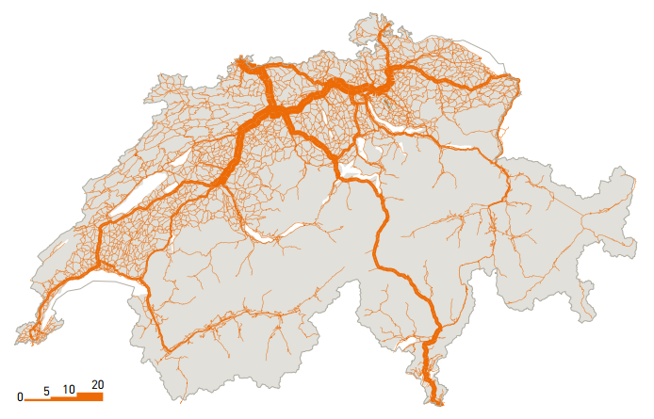
Swiss transport model Introduction
Switzerland is a small country -> short transport distances in comparison with the global model
Many heavy products produced locally are only consumed locally (gravel, concrete, cement)
500x300 km
Waste produced in Switzerland is also treated in Switzerland
If the products are traded only within Switzerland there is – almost certainly – no plane and no ship transport
Transport by road in millions of tons for the year 2012 in Switzerland (ARE, 2014 in Lanz and Hassler, 2015)

Slide 10
Swiss transport model Data sources and their structure
The Statistical Bureau of Switzerland (Swiss Statistics) publishes transport distance and amount (ton*km) information for 20 product groups for road transport
Rail transport from Stucki et al. (2013) matched with NST through Swiss national classification (NOGA)
Rail
Road
NST (EU)
8
20
20
Notes:
NOGA classification, the Swiss general classification of economic activities. NOGA has the same classification as NACE, European Classification of Economic Activities, up to level 4. The transport classes used in Stucki et al. (2013) are a combination of NOGA classes. NACE derives from ISIC

Slide 11
Swiss transport model Matching of the data with the LCI activities
Swiss transport data
Approximately 200 products produced in Switzerland have been identified as not being traded globally, thus in need of regional Swiss market
Matching of the Swiss data (NST) to ISIC
Swiss transport data
ecoinvent v3 – products with Swiss market
ISIC
20
>460
∼200
Notes:
Stucki, C. et al. (2013) Güterverkehrsintensive Branchen und Güterverkehrsströme in der Schweiz. Bundesamt für Strassen. Retrived from: http://www.ub.unibas.ch/digi/a125/sachdok/2013/BAU_1_6153553.pdf, 19 February 2016

Slide 12
Swiss transport model Transport in the market activities
The transport of goods in ecoinvent version 3 is mainly reported in market activities
The market activities represent all the exchanges happening between the producers of the product and the consumers
product x (from activity Y)
market
for product x
reference product x
product x (from activity Z)
transport
waste of product x
(losses in trade and transport)
product x
(losses in trade and transport)

Slide 13
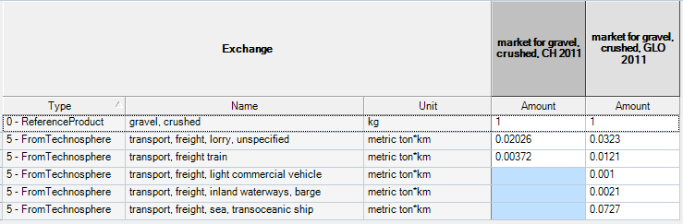
Quality assessment of the new data Comparison of the Swiss and global transport data
Example: market for gravel, round CH versus GLO

Slide 14
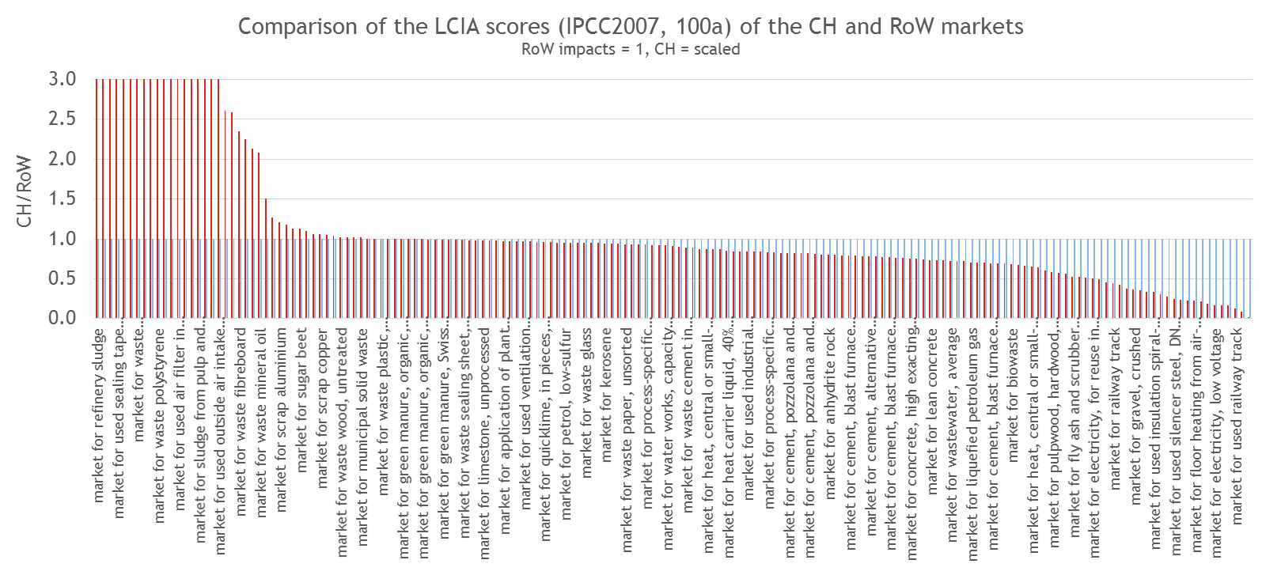
Quality assessment of the new data LCIA scores comparison - markets
24% | 40 | number of CH markets with higher impact (IPCC2007) than RoW
76% | 148 | number of CH markets with lower or equal impact (IPCC2007) than RoW
Notes:
Source file: activity_overview_2016-04-18_cut-off_with_scores_TL
Confirms the theory; the Swiss supply chains are most of the times “cleaner” (because of shorter transport distances and cleaner electricity) than the global ones.

Slide 15
Conclusion
Data availability on transport distances and amounts of goods transported is limited
Global model on transport distances and amounts of goods transported is needed, but can be improved by more regionalized data on a specific products
Significant difference in LCIA scores of many supply chains when using the global model and when including the regional transport distances
Notes:
Data availability limitation
Lack of data on the more detailed regional level
Inconsistent classification -> matching is needed
The classifications are often two coarse (e.g. only 20 product groups)
Trans-continental statistics are very limited
Systematic and consistent approach towards transport data modelling is needed
Conclusion
Significant difference in LCIA scores of many supply chains when using the global model and when including the regional transport distances
Future steps towards the inclusion of more regionalised transport data would be beneficial once more data is available

Slide 16
Questions? Valsasina, L., 2016, Default transport data per commodity group for Switzerland valsasina@ecoinvent.org
Tereza Lévová Senior Data Analyst levova@ecoinvent.org
www.ecoinvent.org

Slide 17
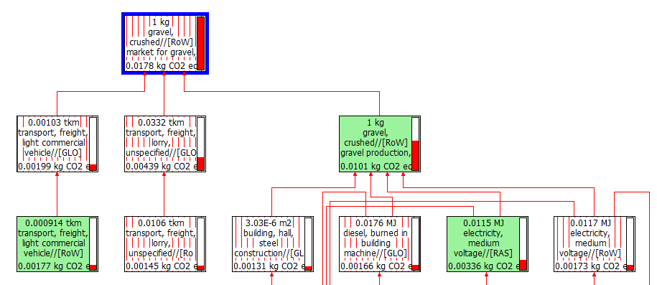
Quality assessment of the new data LCIA scores comparison – changes in the supply chains
Example 2: market for gravel, crushed/ RoW
global transport distances
global supply chains
Notes:
Source file: activity_overview_2016-04-18_cut-off_with_scores_TL

Slide 18
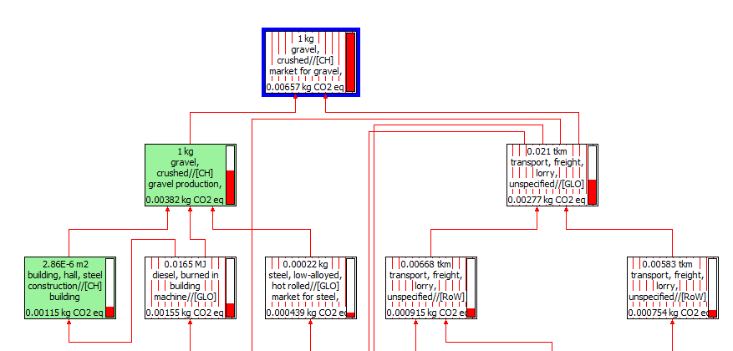
Quality assessment of the new data LCIA scores comparison – changes in the supply chains
Example 2: market for gravel, crushed/ CH
Swiss transport distances
Swiss
supply chains
Notes:
Why is the transport supplied GLO.

